Slide 1




LOGO APP NAME
RESTAURANTS

Slide 2
Open
Input Stream
Social Media
Estimation
Real Time
Input
post

Slide 3
Estimation
Now: 30 minutes
In 5 minutes: 40 minutes
In 10 minutes: 15 minutes
Estimated based on historical data

Slide 4
Real Time
Current Position in Line
a location
another location
another location
another location
20 Minutes
Submit

Slide 5
Open
Input Stream
Estimation
Real Time
Input
post

Slide 6
Estimation
Now: 30 minutes
In 5 minutes: 40 minutes
In 10 minutes: 15 minutes

Slide 7
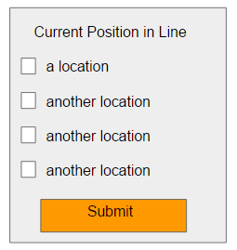
Real Time
20 Minutes

Slide 8
Open
Input Stream
Estimation
Real Time
Input
post

Slide 9
Estimation
Now: 30 minutes
In 5 minutes: 40 minutes
In 10 minutes: 15 minutes
Estimated based on historical data

Slide 10
Real Time
20 Minutes

Slide 11
Open
Quesadilla
Bowl

Slide 12
Quesadilla
Open
Input Stream
Estimation
Real Time
Input
post

Slide 13
Quesadilla
Estimation
Now: 30 minutes
In 5 minutes: 40 minutes
In 10 minutes: 15 minutes
Estimated based on historical data

Slide 14
Quesadilla
Real Time
20 Minutes

Slide 15
Bowl
Open
Input Stream
Estimation
Real Time
Input
post

Slide 16
Bowl
Estimation
Now: 30 minutes
In 5 minutes: 40 minutes
In 10 minutes: 15 minutes
Estimated based on historical data

Slide 17
Bowl
Real Time
20 Minutes

